Slide 1
Convolutional Neural Networks
Qingrun Zhang

Slide 2

What is Convolutional Neural Networks
Convolutional neural networks (ConvNets or CNNs) have superior performance with image and audio signal inputs.
CNN normally consist of the following main type of layers
Convolutional layer
Pooling layer
Fully-connected (FC) layer
Source:https://en.wikipedia.org/wiki/Convolutional_neural_network
Notes:
convolutional layer is the first layer of a convolutional network. While convolutional layers can be followed by additional convolutional layers or pooling layers, the fully-connected layer is the final layer. With each layer, the CNN increases in its complexity, identifying greater portions of the image. Earlier layers focus on simple features, such as colors and edges. As the image data progresses through the layers of the CNN, it starts to recognize larger elements or shapes of the object until it finally identifies the intended object.

Slide 3
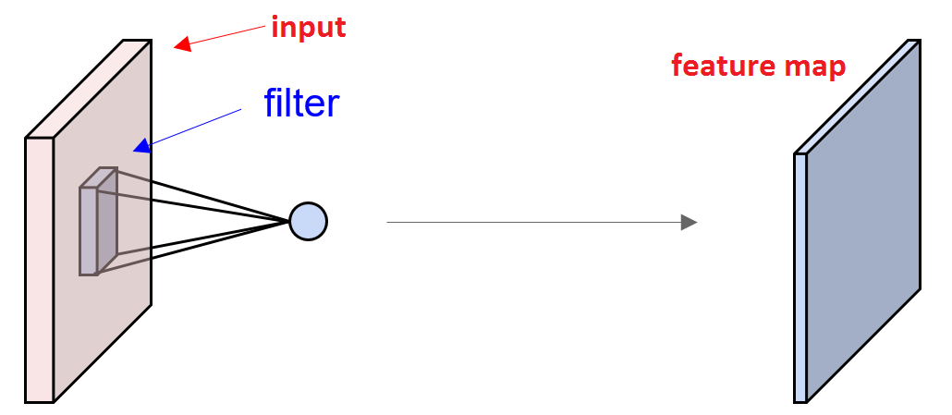
Convolutional Layer
Input image
Feature detector
(kernel or filter)
Notes:
he convolutional layer is the core building block of a CNN, and it is where the majority of computation occurs. It requires a few components, which are input data, a filter, and a feature map. Let’s assume that the input will be a color image, which is made up of a matrix of pixels in 3D. This means that the input will have three dimensions—a height, width, and depth—which correspond to RGB in an image. We also have a feature detector, also known as a kernel or a filter, which will move across the receptive fields of the image, checking if the feature is present. This process is known as a convolution.
The feature detector is a two-dimensional (2-D) array of weights, which represents part of the image. While they can vary in size, the filter size is typically a 3x3 matrix; this also determines the size of the receptive field. The filter is then applied to an area of the image, and a dot product is calculated between the input pixels and the filter. This dot product is then fed into an output array. Afterwards, the filter shifts by a stride, repeating the process until the kernel has swept across the entire image. The final output from the series of dot products from the input and the filter is known as a feature map, activation map, or a convolved feature.

Slide 4
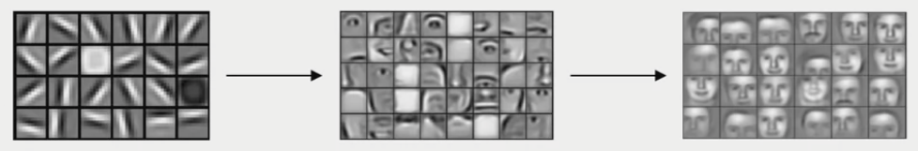
Why convolution operation
For example: 1000 x 1000 pixel image with three RGB channels means that X will be 3 million dimensional. If the first hidden layer has 1000 hidden units, then the total number of weights for the matrix W1 will be a 1000 by 3 million-dimensional matrix..
Notes:
which is just very, very large. And with that many parameters, it's difficult to get enough data to prevent a neural network from overfitting And also, the computational requirements and the memory requirements to train a neural network with three billion parameters is just a bit infeasible. But for computer vision applications, you don't want to be stuck using only tiny little images. You want to use large images. To do that, you need to better implement the convolution operation, which is one of the fundamental building blocks of convolutional neural networks.
Using edge detection as the motivating example, you will see how the convolution operation works. We will talk about how the early layers of the neural network might detect edges and then the some later layers might detect cause of objects and then even later layers may detect cause of complete objects like people's faces in this case.

Slide 5

5 | 6 | 2 | 6 | 8 | 2
1 | 8 | 5 | 9 | 3 | 4
2 | 7 | 2 | 5 | 2 | 1
0 | 1 | 3 | 1 | 7 | 8
4 | 6 | 2 | 4 | 6 | 8
2 | 4 | 5 | 2 | 6 | 9
Vertical edge detector
-1 | 1 | -4
-7
1 | 0 | -1
1 | 0 | -1
1 | 0 | -1
$$∗$$
TensorFlow: tf.nn.cov2d
Keras: Conv2D

Slide 6
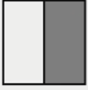

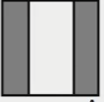

Vertical edge detection
10 | 10 | 10 | 0 | 0 | 0
10 | 10 | 10 | 0 | 0 | 0
10 | 10 | 10 | 0 | 0 | 0
10 | 10 | 10 | 0 | 0 | 0
10 | 10 | 10 | 0 | 0 | 0
10 | 10 | 10 | 0 | 0 | 0
0 | 30 | 30 | 0
0 | 30 | 30 | 0
0 | 30 | 30 | 0
0 | 30 | 30 | 0
1 | 0 | -1
1 | 0 | -1
1 | 0 | -1
$$∗$$
Source Andrew Ng

Slide 7




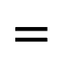

10 | 10 | 10 | 0 | 0 | 0
10 | 10 | 10 | 0 | 0 | 0
10 | 10 | 10 | 0 | 0 | 0
10 | 10 | 10 | 0 | 0 | 0
10 | 10 | 10 | 0 | 0 | 0
10 | 10 | 10 | 0 | 0 | 0
1 | 0 | -1
1 | 0 | -1
1 | 0 | -1
0 | 30 | 30 | 0
0 | 30 | 30 | 0
0 | 30 | 30 | 0
0 | 30 | 30 | 0
$$=$$
$$∗$$
0 | 0 | 0 | 10 | 10 | 10
0 | 0 | 0 | 10 | 10 | 10
0 | 0 | 0 | 10 | 10 | 10
0 | 0 | 0 | 10 | 10 | 10
0 | 0 | 0 | 10 | 10 | 10
0 | 0 | 0 | 10 | 10 | 10
0 | -30 | -30 | 0
0 | -30 | -30 | 0
0 | -30 | -30 | 0
0 | -30 | -30 | 0
1 | 0 | -1
1 | 0 | -1
1 | 0 | -1
$$∗$$
$$=$$
Source Andrew Ng

Slide 8
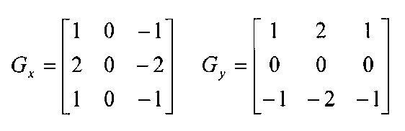
Edge Detection Methods
Sobel edge detector
The Sobel edge enhancement filter has the advantage of providing differentiating (which gives the edge response) and smoothing (which reduces noise) concurrently.
Put more weight in the middle
Gy and Gx are gradient x direction and y direction respectively.
Vertical edge detector
Horizontal edge detector
Source: https://docs.opencv.org/3.4/d2/d2c/tutorial_sobel_derivatives.html

Slide 9
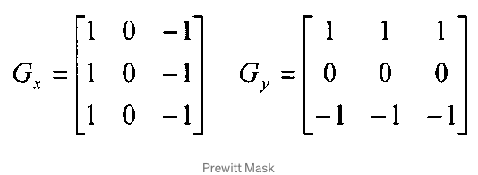
Prewitt edge detector
This operator does not place any emphasis on the pixels that are closer to the center of the mask.
Source: https://docs.opencv.org/3.4/d2/d2c/tutorial_sobel_derivatives.html

Slide 10
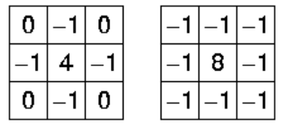
Laplacian Operator
The Laplacian edge detector uses only one kernel. It calculates second order derivatives in a single pass. Two commonly used small kernels are:
Because these masks are approximating a second derivative measurement on the image, they are very sensitive to noise. To correct this, the image is often Gaussian smoothed before applying the Laplacian filter.
Source: https://docs.opencv.org/3.4/d5/db5/tutorial_laplace_operator.html

Slide 11
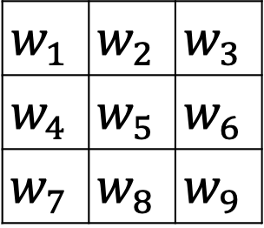


Learning weight for the filter
5 | 6 | 2 | 6 | 8 | 2
1 | 8 | 5 | 9 | 3 | 4
2 | 7 | 2 | 5 | 2 | 1
0 | 1 | 3 | 1 | 7 | 8
4 | 6 | 2 | 4 | 6 | 8
2 | 4 | 5 | 2 | 6 | 9
$$w_{1}$$ | $$w_{2}$$ | $$w_{3}$$
$$w_{4}$$ | $$w_{5}$$ | $$w_{6}$$
$$w_{7}$$ | $$w_{8}$$ | $$w_{9}$$
$$∗$$
$$=$$
Notes:
And with the rise of deep learning, one of the things we learned is that when you really want to detect edges in some complicated image, maybe you don't need to have computer vision researchers handpick these nine numbers. Maybe you can just learn them and treat the nine numbers of this matrix as parameters, which you can then learn using back propagation. And the goal is to learn nine parameters so that when you take the image, the six by six image, and convolve it with your three by three filter, that this gives you a good edge detector. the idea you can treat these nine numbers as parameters to be learned has been one of the most powerful ideas in computer vision

Slide 12

Padding
Shrinking output
Throw away information form edge
$$w_{1}$$ | $$w_{2}$$ | $$w_{3}$$
$$w_{4}$$ | $$w_{5}$$ | $$w_{6}$$
$$w_{7}$$ | $$w_{8}$$ | $$w_{9}$$
$$∗$$
$$=$$
6 x 6
n x n
3 x 3
f x f
4 x 4
(n-f+1) x (n-f+1)
Notes:
What we saw in earlier videos is that if you take a six by six image and convolve it with a three by three filter, you end up with a four by four output with a four by four matrix, and that's because the number of possible positions with the three by three filter, there are only, sort of, four by four possible positions, for the three by three filter to fit in your six by six matrix

Slide 13
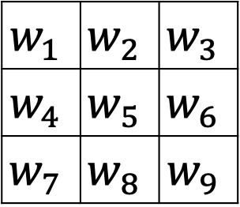
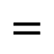

Padding
(n+2p) x(n+2p)
0
0
(n+2p-f+1) x(n+2p-f+1)
f x f
$$w_{1}$$ | $$w_{2}$$ | $$w_{3}$$
$$w_{4}$$ | $$w_{5}$$ | $$w_{6}$$
$$w_{7}$$ | $$w_{8}$$ | $$w_{9}$$
$$∗$$
$$=$$
P =padding =1, 6 x 6 => 8 x 8

Slide 14
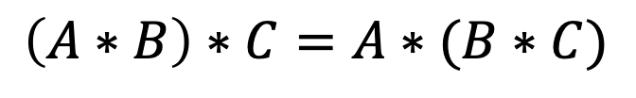
Valid and Same convolutions
Valid padding: no padding
(n x n) * (f x f) --> (n-f+1) x (n-f +1)
Same padding: Pad to make output size the same as the input size:
n=n+2p-f+1 => p=(f-1)/2, f is usually odd number
Full padding: increases the size of the output by adding zeros to the border of the input.
Convolution follows the association rule
$$\left(A∗B\right)∗C=A∗(B∗C)$$

Slide 15
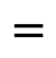
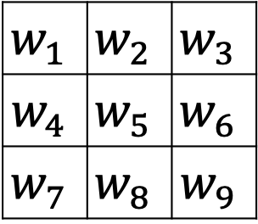
Stride
$$w_{1}$$ | $$w_{2}$$ | $$w_{3}$$
$$w_{4}$$ | $$w_{5}$$ | $$w_{6}$$
$$w_{7}$$ | $$w_{8}$$ | $$w_{9}$$
$$∗$$
$$=$$
$$n × n ∗f × f with stride S⇒\left\lfloor \frac{n+2p−f}{s}+1\right\rfloor × \left\lfloor \frac{n+2p−f}{s}+1\right\rfloor$$

Slide 16
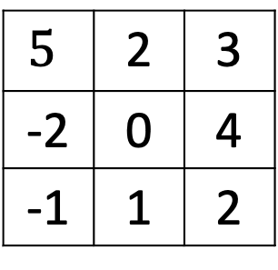
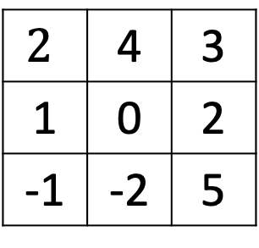
Cross-correlation vs convolution
Cross-correlation and convolution are both operations applied to images.
Cross-correlation means sliding a kernel (filter) across an image.
Convolution means sliding a flipped kernel across an image.
Most CNN libraries are actually using cross-correlation, but still call it convolution
$$2$$ | 4 | 3
1 | 0 | 2
-1 | -2 | 5
$$∗$$
$$5$$ | 2 | 3
-2 | 0 | 4
-1 | 1 | 2
https://medium.com/towards-data-science/convolution-vs-cross-correlation-81ec4a0ec253

Slide 17
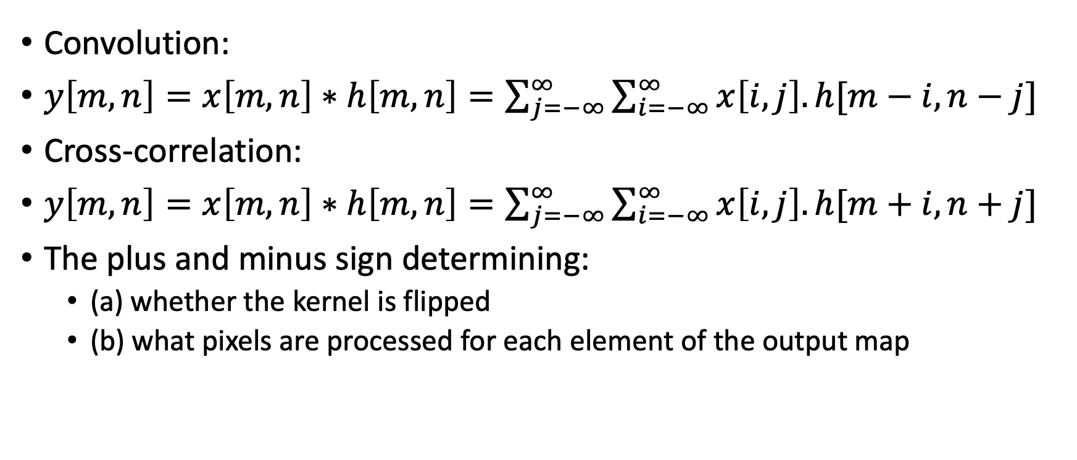
Cross-correlation and convolution
Convolution:
$y\left[m,n\right]=x\left[m,n\right]∗h\left[m,n\right]=\sum_{j=−∞}^{∞}{\sum_{i=−∞}^{∞}{x\left[i,j\right].h[m−i,n−j]}}$
Cross-correlation:
$y\left[m,n\right]=x\left[m,n\right]∗h\left[m,n\right]=\sum_{j=−∞}^{∞}{\sum_{i=−∞}^{∞}{x\left[i,j\right].h[m+i,n+j]}}$
The plus and minus sign determining:
(a) whether the kernel is flipped
(b) what pixels are processed for each element of the output map
-3 -2 -1 0 1 2 3

Slide 18

Convolutions over volume
$$=$$
$$∗$$
6 x 6 x 3
3 x 3 x 3
4 x 4
Height
Width
#channels

Slide 19

Multiple filters
Vertical Edge
$$=$$
$$∗$$
Horizontal edge
$$∗$$
$$=$$
4 x 4 x 2
n x n x n_{c}
f x f x n_{c}
(n-f+1) x (n-f+1) x n’_{c}

Slide 20
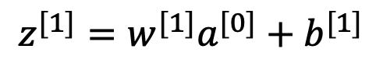
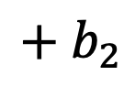
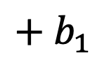
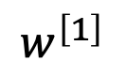
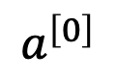
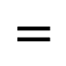
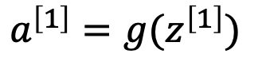
Convolutional Network
$$a^{\left[1\right]}=g(z^{\left[1\right]})$$
$$z^{[1]}=w^{[1]}a^{[0]}+b^{[1]}$$
$$a^{\left[0\right]}$$
Vertical Edge
ReLU
$$+ b_{1}$$
=
$$=$$
$$∗$$
$$w^{\left[1\right]}$$
Horizontal edge
$$∗$$
$$=$$
ReLU
$$+ b_{2}$$
=
6 x 6 x 3
3 x 3 x 3
4 x 4
Notes:
After each convolution operation, a CNN applies a Rectified Linear Unit (ReLU) transformation to the feature map, introducing nonlinearity to the model.

Slide 21
Number of parameters for one layer
If you have 2 filters that are 3 x 3 x 3 in one layer of neural network, how many parameters are there?
3 x 3 x 3 + 1 =28 for one filter
No matter how large the input image is, the parameters will be the same if you have same number of filters and same dimensions

Slide 22
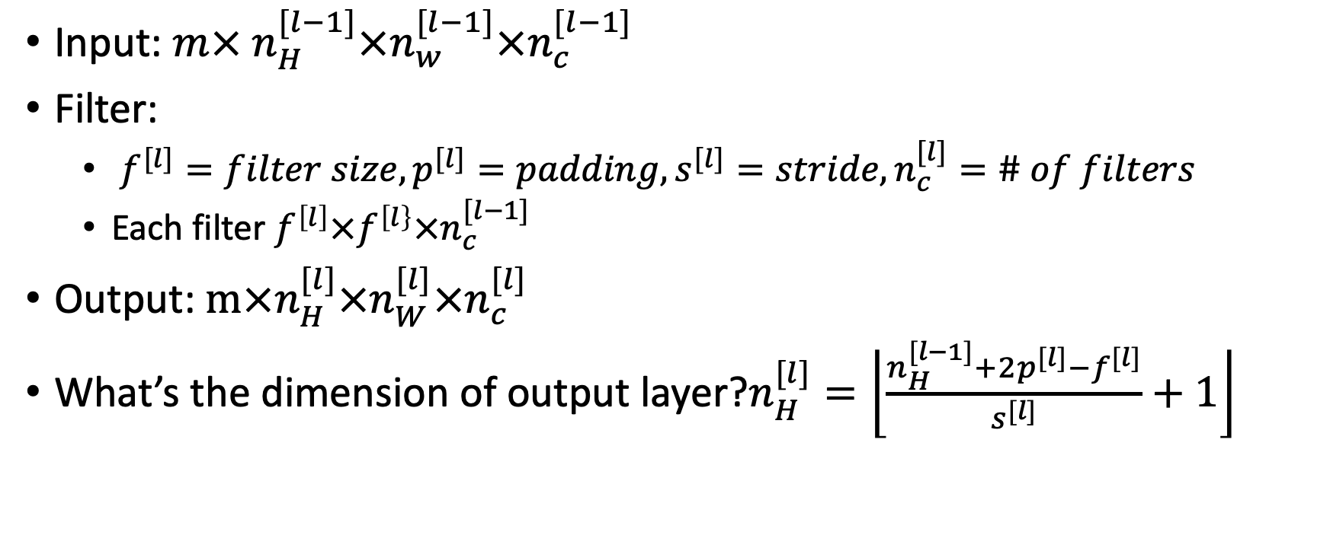
Summery of notation
Input: ${m× n}_{H}^{[l−1]}×n_{w}^{[l−1]}×n_{c}^{[l−1]}$
Filter:
$f^{[l]}=filter size, p^{[l]}=padding, s^{[l]}=stride, n_{c}^{[l]}=\# of filters$
Each filter $f^{\left[l\right]}×f^{\left[l\right\}}×n_{c}^{[l−1]}$
Output: $m×n_{H}^{[l]}×n_{W}^{[l]}×n_{c}^{[l]}$
What’s the dimension of output layer?$n_{H}^{[l]}=\left\lfloor \frac{n_{H}^{[l−1]}+2p^{[l]}−f^{[l]}}{s^{[l]}}+1\right\rfloor$

Slide 23
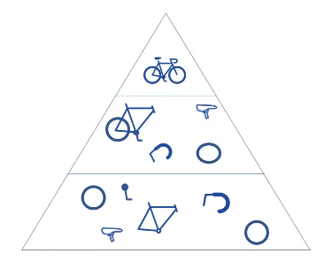
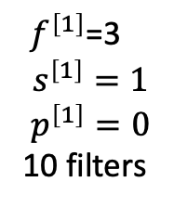
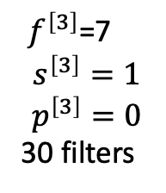
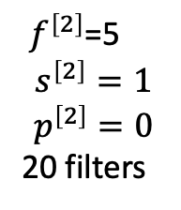
Convolutional Neural Network Example
${ f}^{\left[1\right]}$=3
$$s^{\left[1\right]}=1$$
$$p^{\left[1\right]}=0$$
10 filters
${ f}^{\left[2\right]}$=5
$$s^{\left[2\right]}=1$$
$$p^{\left[2\right]}=0$$
20 filters
${ f}^{\left[3\right]}$=7
$$s^{\left[3\right]}=1$$
$$p^{\left[3\right]}=0$$
30 filters
65 x 65 x 3
Number of filters increase as the convolution layers increase
Notes:
As we mentioned earlier, another convolution layer can follow the initial convolution layer. When this happens, the structure of the CNN can become hierarchical as the later layers can see the pixels within the receptive fields of prior layers. As an example, let’s assume that we’re trying to determine if an image contains a bicycle. You can think of the bicycle as a sum of parts. It is comprised of a frame, handlebars, wheels, pedals, et cetera. Each individual part of the bicycle makes up a lower-level pattern in the neural net, and the combination of its parts represents a higher-level pattern, creating a feature hierarchy within the CNN.

Slide 24
Pooling Layers
Pooling layers conduct dimensionality reduction for the input layer
Pooling layers help to reduce complexity, improve efficiency, and limit risk of overfitting.
Max pooling
Average pooling
8 | 9
7 | 5
5 | 6 | 2 | 6
1 | 8 | 5 | 9
2 | 7 | 2 | 5
0 | 1 | 3 | 1
Max
5 | 5.5
2.5 | 2.75
Average
Hyperparameters:
filter=2,
stride =2
No parameters to learn
Notes:
Pooling layers, also known as downsampling, conducts dimensionality reduction, reducing the number of parameters in the input. Similar to the convolutional layer, the pooling operation sweeps a filter across the entire input, but the difference is that this filter does not have any weights. Instead, the kernel applies an aggregation function to the values within the receptive field, populating the output array. There are two main types of pooling

Slide 25
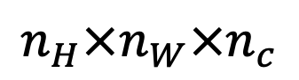
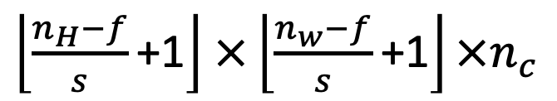
Pooling layer example
5 | 6 | 2 | 6 | 8 | 2
1 | 8 | 5 | 9 | 3 | 4
2 | 7 | 2 | 5 | 2 | 1
0 | 1 | 3 | 1 | 7 | 8
4 | 6 | 2 | 4 | 6 | 8
2 | 4 | 5 | 2 | 6 | 9
8 | 9 | 9 | 9
8 | 9 | 9 | 9
7 | 7 | 6 | 8
6 | 6 | 6 | 9
Filter=3
Stride =1
$\left\lfloor \frac{n_{H}−f}{s}\text{+1}\right\rfloor$ $×\left\lfloor \frac{n_{w}−f}{s}\text{+1}\right\rfloor ×n_{c}$
$$n_{H}×n_{W}×n_{c}$$

Slide 26

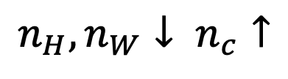
Typical structure of CNN
$$n_{H},n_{W}↓ n_{c}↑$$
Layer 1
Conv->pool->Conv->Pool->FC->FC-FC-SoftMax
https://towardsdatascience.com/a-comprehensive-guide-to-convolutional-neural-networks-the-eli5-way-3bd2b1164a53
Notes:
When people report the number of layers in a neural network usually people just record the number of layers that have weight, that have parameters. And because the pooling layer has no weights, has no parameters, only a few hyper parameters, I'm going to use a convention that Conv 1 and Pool 1 shared together.

Slide 27
Why Convolutions?
Filter
F=5
Stride =1
Padding =0
For filter, 5 x 5 = 25 Weights+ 1 bias =26
6 x 26 =156 parameters
Parameter sharing: Same filter apply on multiple part of the image
Sparsity of connections: Each lary, each output value depends on a small number of inputs
32 x 32 x 3
3072
28 x 28 x 6
4704
10 | 10 | 10 | 0 | 0 | 0
10 | 10 | 10 | 0 | 0 | 0
10 | 10 | 10 | 0 | 0 | 0
10 | 10 | 10 | 0 | 0 | 0
10 | 10 | 10 | 0 | 0 | 0
10 | 10 | 10 | 0 | 0 | 0
0 | 30 | 30 | 0
0 | 30 | 30 | 0
0 | 30 | 30 | 0
0 | 30 | 30 | 0
1 | 0 | -1
1 | 0 | -1
1 | 0 | -1
$$∗$$
$$=$$
3072 x 4704 parameters
Notes:
And the reason that a convnet has run to these small parameters is really two reasons. One is parameter sharing. And parameter sharing is motivated by the observation that feature detector such as vertical edge detector, that's useful in one part of the image is probably useful in another part of the image. And what that means is that, if you've figured out say a three by three filter for detecting vertical edges, you can then apply the same three by three filter over here, and then the next position over, and the next position over, and so on. And so, each of these feature detectors, each of these outputs can use the same parameters in lots of different positions in your input image in order to detect say a vertical edge or some other feature.

Slide 28
Convolutional Neural Network
Kunihiko Fukushima and Yann LeCun laid the foundation of research for convolutional neural networks in their work in 1980.
Yann LeCun successfully applied backpropagation to train neural networks to identify and recognize patterns within handwritten zip codes. He culminated with LeNet-5
Variant of CNN architectures have emerged with the introduction of new datasets, such as MNIST and CIFAR-10, and competitions, like ImageNet Large Scale Visual Recognition Challenge (ILSVRC).

Slide 29
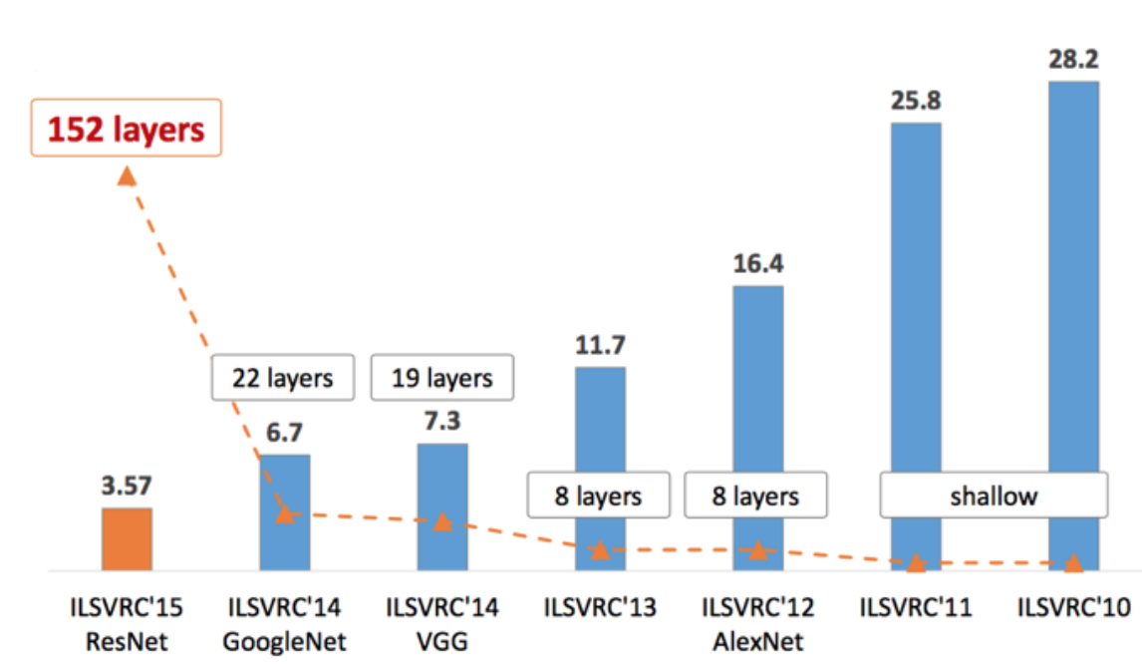
CNN architectures
https://medium.com/analytics-vidhya/cnns-architectures-lenet-alexnet-vgg-googlenet-resnet-and-more-666091488df5

Slide 30
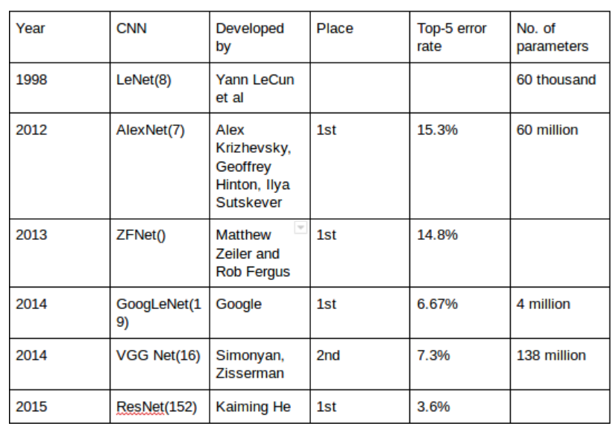
Classic Convolutional Neural Network

Slide 31
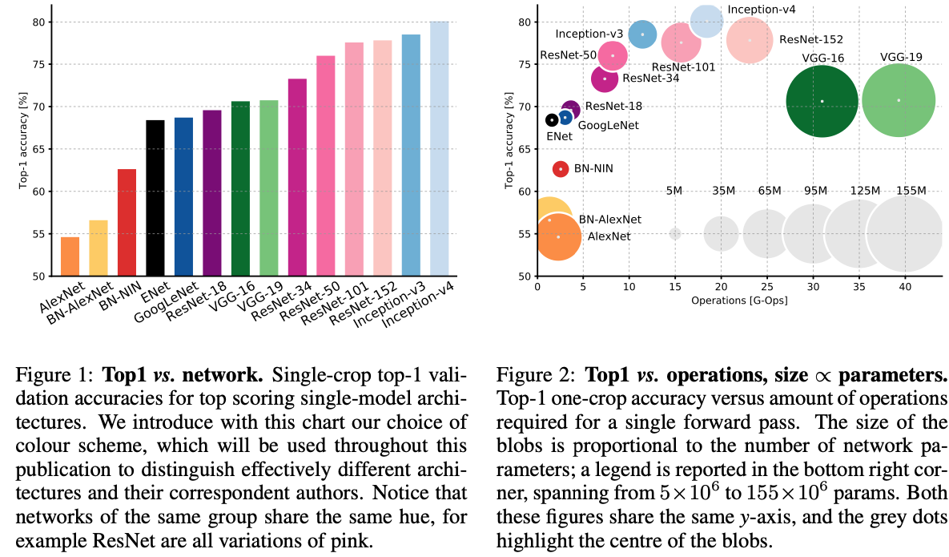
https://arxiv.org/pdf/1605.07678.pdf

Slide 32
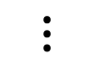
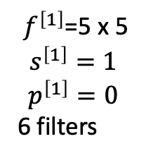
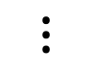
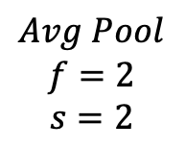
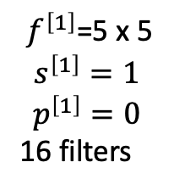
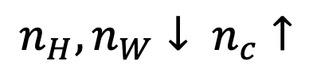
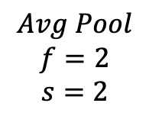
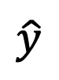
LeNet-5
$$Avg Pool$$
$$f=2$$
$$s=2$$
${ f}^{\left[1\right]}$=5 x 5
$$s^{\left[1\right]}=1$$
$$p^{\left[1\right]}=0$$
16 filters
FC
FC
$$Avg Pool$$
$$f=2$$
$$s=2$$
${ f}^{\left[1\right]}$=5 x 5
$$s^{\left[1\right]}=1$$
$$p^{\left[1\right]}=0$$
6 filters
9
$$⋮$$
$$\hat{y}$$
$$⋮$$
32 x 32 x 1
28 x 28 x 6
14 x 14 x 6
10 x 10 x 16
5 x 5 x 16
120
84
LeNet-5 is known as the classic CNN architecture.
LeCun et al., 1998 Gradient-based learning applied to automatically classify hand-written digits on bank cheques in the United States.
60K parameters.
Non-linearity after pooling using Sigmoid/tanh instead of ReLU
$$n_{H},n_{W}↓ n_{c}↑$$
Notes:
to save on computation as well as some parameters, the original LeNet-5 had some crazy complicated way where different filters would look at different channels of the input block. And so the paper talks about those details, but the more modern implementation wouldn't have that type of complexity these days.
individual convolutional kernels in the layer C2 do not use all of the features produced by the layer S2, which is very unusual by today’s standard. One reason for that is to made the network less computationally demanding. The other reason was to make convolutional kernels learn different patterns. This makes perfect sense: if different kernels receive different inputs, they will learn different patterns.

Slide 33
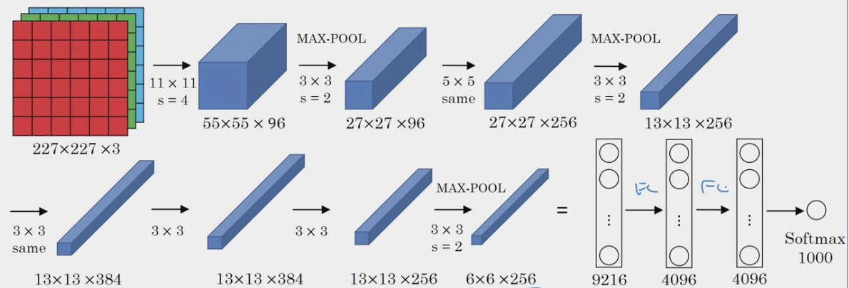
AlexNet
AlexNet reduced the top-5 error from 26% to 15.3%
ReLU activations after every convolutional and fully-connected layer.
Multiple GPUs
Local Response Normalization (not very useful)
Krizhevsky et al, 2012 NIPS. ImageNet Classification with Deep Convolutional Neural Networks
Source: Andrew NG

Slide 34

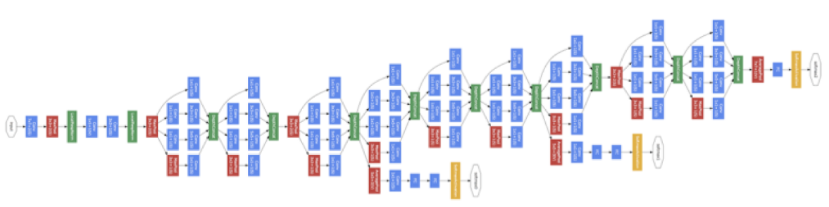



ZFNet(2013): It achieved a top-5 error rate of 14.8%. It tweaked the hyper-parameters of AlexNet while keep the same structure.
GoogLeNet/Inception(2014). It achieved a top-5 error rate of 6.67%!
The human expert (Andrej Karpathy) achieve a top-5 error rate of 5.1%(single model) and 3.6%(ensemble).
A CNN inspired by LeNet with a novel inception module.
It used batch normalization, image distortions and RMSprop.
This module is based on several very small convolutions in order to drastically reduce the number of parameters.

Slide 35
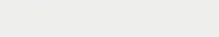
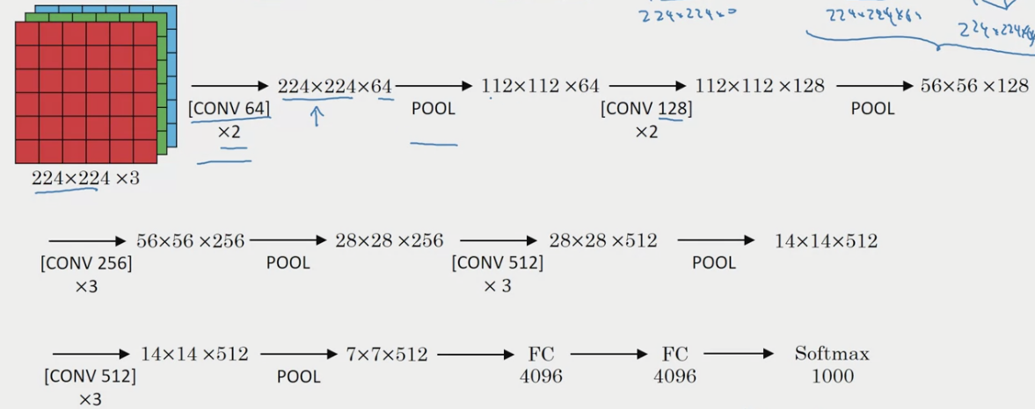
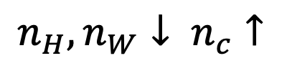
VGGNet 16(2014)
Very uniform architecture. 3x3 convolutions, but lots of filters, 138 million parameters
$$n_{H},n_{W}↓ n_{c}↑$$
Karen Simonyan, Andrew Zisserman, 2014
Source: Andrew NG
Notes:
VGGNet is a pretty large network, this network has a total of about 138 million parameters. And that's pretty large even by modern standards. But the simplicity of the VGG-16 architecture made it quite appealing. You can tell his architecture is really quite uniform. There is a few conv-layers followed by a pulling layer, which reduces the height and width,

Slide 36
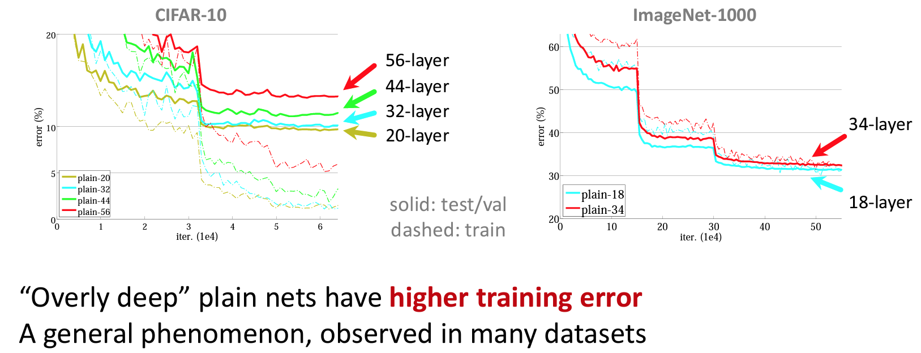
Will stacking more layers make network learning better?
http://kaiminghe.com/ilsvrc15/ilsvrc2015_deep_residual_learning_kaiminghe.pdf

Slide 37
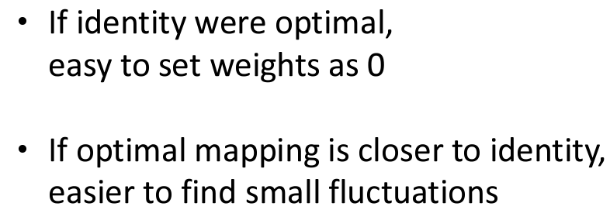


ResNets Deep Residual Learning
It achieves a top-5 error rate of 3.57%, beat human performance
“Ultra-deep” (quote Yann) 152-layer nets
http://kaiminghe.com/ilsvrc15/ilsvrc2015_deep_residual_learning_kaiminghe.pdf

Slide 38


ResNet
Basic Design (VGG-style)
All 3 x 3 Conv
Spatial size/2=> # filters x2
Simple design, just deep!
No max pooling
No hidden fc
No dropout
ResNet
Plain Net
http://kaiminghe.com/ilsvrc15/ilsvrc2015_deep_residual_learning_kaiminghe.pdf

Slide 39

ResNet
http://kaiminghe.com/ilsvrc15/ilsvrc2015_deep_residual_learning_kaiminghe.pdf

Slide 40








Why do residual networks work?
$$x$$
Big NN
$$a^{[l]}$$
$$a^{[l]}$$
$$x$$
Big NN
$$a^{[l+2]}$$
$$⋮$$
$$⋮$$
ReLU will make $a^{[l]}≥0,$
$$a^{\left[l+2\right]}=g\left(z^{\left[l+1\right]}+a^{\left[l\right]}\right)=g\left(w^{\left[l+1\right]}a^{\left[l+1\right]}+b^{\left[l+1\right]}+a^{\left[l\right]}\right),$$
$$if w^{\left[l+1\right]}=0, b^{\left[l+1\right]}=0, a^{\left[l+2\right]}=g\left(a^{\left[l\right]}\right)=a^{\left[l\right]}$$
Notes:
Let's go through one example that illustrates why ResNets work so well. What we saw on the last video was that if you make a network deeper, it can hurt your ability to train the network to do well on the training set.
Let's say you have X feeding in to some big neural network and just outputs some activation a[l]. if you modify the neural network to make it a little bit deeper. we're using the ReLU activation functions. So, all the activations are going to be greater than or equal to zero, with the possible exception of the input X. let's look at what's a[l+2] will be.
Now notice something, if you are using L two regularisation away to K, that will tend to shrink the value of w[l+2]. If you are applying way to K to B that will also shrink this although I guess in practice sometimes you do and sometimes you don't apply way to K to B, but W is really the key term to pay attention to here. And if w[l+2] is equal to zero. And let's say for the sake of argument that B is also equal to zero, then these terms go away because they're equal to zero, and then g of a[l], this is just equal to a[l] because we assumed we're using the ReLU activation function. So, g of a[l] is a[l]. So, what this shows is that the identity function is easy for residual block to learn. And it's easy to get a[l+2] equals to a[l] because of this skip connection. And what that means is that adding these two layers in your neural network, it doesn't really hurt your neural network's ability to do as well as this simpler network without these two extra layers, because it's quite easy for it to learn the identity function to just copy a[l] to a[l+2] using despite the addition of these two layers. And this is why adding two extra layers, adding this residual block to somewhere in the middle or the end of this big neural network it doesn't hurt performance. But of course our goal is to not just not hurt performance, is to help performance and so you can imagine that if they actually learned something useful then maybe you can do even better than learning the identity function.
the main reason the residual network works is that it's so easy for these extra layers to learn the identity function that you're kind of guaranteed that it doesn't hurt performance and then a lot the time you maybe get lucky and then even helps performance.
So, one more detail, we're assuming that z[l+2] and a[l] have the same dimension. And ResNet use a lot of same convolutions. because the same convolution preserve dimensions,
and so makes that easier for you to carry out this short circle and then carry out this addition of two equal dimension vectors. In case the input and output have different dimensions so for example, if this is a 128 dimensional and Z or therefore, a[l] is 256 dimensional as an example. What you would do is add an extra matrix and then call that Ws over here, and Ws in this example would be a[l] 256 by 128 dimensional matrix. So then Ws times a[l] becomes 256 dimensional and this addition is now between two 256 dimensional vectors and there are few things you could do with Ws, it could be a matrix of parameters we learned, it could be a fixed matrix that just implements zero paddings that takes a[l] and then zero pads it to be 256 dimensional
because the same convolutions, the dimensions are preserved and so the z[l+2] plus a[l] by addition makes sense. ResNet have a bunch of convolutional layers and then there are occasionally pulling layers as well or pulling a pulling likely is. And whenever one of those things happen, then you need to make an adjustment to the dimension

Slide 41


Network in Network, 1x1 Convolutions
2 | 6 | 8
5 | 9 | 3
2 | 5 | 2
6 | 18 | 24
10 | 18 | 6
4 | 10 | 4
$$∗$$
3
$$=$$
Lin et al 2013 Network In Network
https://towardsdatascience.com/a-basic-introduction-to-separable-convolutions-b99ec3102728
Notes:
a convolution with a one-by-one filter can do something that makes much more sense when we apply it to multiple channels

Slide 42

1x1 Convolutions expand channels
256

Slide 43

1 x 1 convolution shrink channels
Source Andrew NG
Lin et al 2013 Network In Network

Slide 44

Naïve inception module
Source Andrew NG
Szegedy et al 2014 Going deeper with convolution
Notes:
the “naive” inception module. It performs convolution on an input, with 3 different sizes of filters (1x1, 3x3, 5x5). Additionally, max pooling is also performed. The outputs are concatenated and sent to the next inception module.
you have inputted a 28 by 28 by 192-dimensional volume. So what the inception network or what an inception layer says is, instead choosing what filter size you want in a Conv layer, or even do you want a convolutional layer or a pooling layer? Let's do them all. So what if you can use a 1 by 1 convolution, and that will output a 28 by 28 by 64 output, and you just have a volume there. But maybe you also want to try a 3 by 3 and that might output a 20 by 20 by 128. And then what you do is just stack up this second volume next to the first volume. And to make the dimensions match up, let's make this a same convolution. So the output dimension is still 28 by 28, same as the input dimension in terms of height and width. But 28 by 28 by in this example 128. And maybe you might say well I want to hedge my bets. Maybe a 5 by 5 filter works better. So let's do that too and have that output a 28 by 28 by 32. And again you use the same convolution to keep the dimensions the same. And maybe you don't want to convolutional layer. Let's apply pooling, and that has some other output and let's stack that up as well. And here pooling outputs 28 by 28 by 32. Now in order to make all the dimensions match, you actually need to use padding for max pooling. So this is an unusual formal pooling because if you want the input to have a higher than 28 by 28 and have the output, you'll match the dimension everything else also by 28 by 28, then you need to use the same padding as well as a stride of one for pooling. So this detail might seem a bit funny to you now, but let's keep going. And we'll make this all work later. But with a inception module like this, you can input some volume and output. In this case, I guess if you add up all these numbers, 32 plus 32 plus 128 plus 64, that's equal to 256. So you will
there is a problem with the inception layer as we've described it here, which is computational cost.

Slide 45



Why?
Salient parts: image can have extremely large variation in size. E.g. the area occupied by cat is different
Huge variation makes kernel size choosing difficult. A larger kernel is better for globally distributed information. A smaller kernel suite for information that is distributed more locally.
Very deep networks are prone to overfitting.
Naively stacking large convolution operations is computationally expensive.
Solution: filters with multiple sizes operate on the same level

Slide 46
Computational cost
28 x 28 x 192
28 x 28 x 32
Each filter: 5 x 5 x 192
# of computing:
28x28x32x5x5x192=120 M
CONV
Same 5x5
32
CONV
1x1x192
16
28 x 28 x 16
Bottleneck
28 x 28 x 32
CONV
5 x 5
32
# of computing:
28x28x16x192
# of computing:
28x28x32x5x5x16
+
=
12.4M
Notes:
And what you saw here was how using a 1 by 1 convolution, you can create this bottleneck layer thereby reducing the computational cost significantly. Now you might be wondering, does shrinking down the representation size so dramatically, does it hurt the performance of your neural network? It turns out that so long as you implement this bottleneck layer so that within reason, you can shrink down the representation size significantly, and it doesn't seem to hurt the performance, but saves you a lot of computation. So these are the key ideas of the inception module.

Slide 47


Naïve inception module
1 x 1
CONV
1 x 1 x 64
1 x 1
CONV
3 x 3
CONV
1 x 1 x 96
Previous
Activation
Channel
Concatenate
1 x 1 x 16
1 x 1
CONV
5 x 5
CONV
28 x 28 x 192
MAXPOOL
3x3, S=1
Same
1 x 1
CONV
28 x 28 x 192

Slide 48

MobileNet (separable convolutions)
MobileNets are specifically designed for low compute environment, such as a mobile phone.
Input:
The spatial dimensions: the width and the height
The depth dimension: the number of channels
Separable convolutions
Spatial separable convolutions
Divde kernel into two smaller kernels. E.g. 3 x 3 into 3 x 1 and 1 x 3
Depthwise separable convolutions.
Howard et al, 2017 MobileNets: Efficient Convolutional Neural Networks for Mobile Vision Applications

Slide 49

Spatial Separable Convolution
9 multiplications
6 multiplications
Not all kernels can be separated into two
https://towardsdatascience.com/a-basic-introduction-to-separable-convolutions-b99ec3102728

Slide 50


Normal convolutions
3x3x3 =27
$$∗$$
$$=$$
6 x 6 x N
K x K
H x W x M
Number of calculation: $KKNHWM$
When convolution is performed on both spatial and channel domain, the computational cost of standard convolution is proportional to.
the spatial size of the output feature map H x W
the size of convolution kernel K²
the numbers of input and output channels N x M.

Slide 51

Depthwise Separable Convolutions
Depthwise separable convolution deals with the spatial dimensions, and the depth dimension
Splits a kernel into two separate kernels that do two convolutions:
The depthwise convolution
The pointwise convolution
keras.layers.SeparableConv2D or tf.layers.separable_conv2d
Computation cost for normal convolution
5 x 5 x 8 x 8 x 3 x 256
=1228800

Slide 52


The depthwise convolution
Computation cost:
5 x 5 x 8 x 8 x3
=4800
3 kernels, each 5 x 5 x 1
4800+49152=53952
53952/1228800=0.044
The pointwise convolution
Computation cost:
1 x 1 x 8 x 8 x3 x 256
=49152
256 kernels, each 1 x 1 x 3
Notes:
In the normal convolution, we are transforming the image 256 times. And every transformation uses up 5x5x3x8x8=4800 multiplications.
In the separable convolution, we only really transform the image once — in the depthwise convolution. Then, we take the transformed image and simply elongate it to 256 channels. Without having to transform the image over and over again, we can save up on computational power.

Slide 53
Disadvantages with Depthwise Separable Convolutions
Depthwise Separable Convolutions reduces the number of parameters in a convolution, if your network is already small, you might end up with too few parameters and your network might fail to properly learn during training
1 x 1 kernel:
Used for increase or reduce the depth of an input tesor
Apply non-linearity. Non-linear layer expand the possibilities for the model
Used for increase or reduce the depth of an input tesor

Slide 54





MobileNet Architecture
MobileNet V1
13 times
Pooling, FC, SoftMax
Residual Connection
Pooling, FC
SoftMax
Expansion
Depthwise
Projection
Bottleneck Block
17 times
Sandler et al 2019 MobileNetV2: Inverted Residuals and Linear Bottlenecks
Notes:
In MobileNet v2, there are two main changes. One is the addition of a residual connection. This residual connection or skip connection, takes the input from the previous layer and sums it or passes it directly to the next layer, does allow ingredients to propagate backward more efficiently. The second change is that it also has an expansion layer, before the depthwise convolution, followed by the pointwise convolution, which we're going to call projection in a point-wise convolution. Is really the same operation, but we'll give it a different name

Slide 55
Expansion
Depthwise
Projection
n x n x 3
n x n x 18
n x n x 18
n x n x 3
The expansion operation increases the size of the representation within the bottleneck block. This allows the neural network to learn a richer function.
The projection operation project it back down to a smaller set of values, to accommodate the limited resource on mobile device
https://medium.com/towards-data-science/mobilenetv2-inverted-residuals-and-linear-bottlenecks-8a4362f4ffd5
Notes:
But when deploying on a mobile device, you will often be heavy memory constraints. The bottleneck block uses the pointwise convolution or the projection operation in order to project it back down to a smaller set of values, so that when you pass this the next block, the amount of memory needed to store these values is reduced back down. The clever idea, The cool thing about the bottleneck block is that it enables a richer set of computations, thus allow your neural network to learn richer and more complex functions, while also keeping the amounts of memory that is the size of the activations you need to pass from layer to layer, relatively small. That's why the MobileNet v2 can get a better performance than MobileNet v1, while still continuing to use only a modest amount of compute and memory resources.

Slide 56

EfficientNet
There are three scaling dimensions of a CNN: depth,width, and resolution
Depth: Deeper network can capture richer and more complex features
Gradient vanishing as we go deep
ResNet avoid gradients vanishing, but accuracy saturates quickly
Width: Wider network can capture more fine-grained features
Shallow models (less deep but wider) accuracy saturates quickly with larger width.
Resolution: High resolution image have more fine-grained features
Notes:
Vanishing gradients is one of the most common problems that arises as we go deep

Slide 57

Mingxing Tan, Quoc V. Le 2020 EfficientNet: Rethinking Model Scaling for Convolutional Neural Networks

Slide 58


Slide 59

compound scaling method
where α, β, γ are constants that can be determined by a small grid search. Intuitively, φ is a user-specified coeffi- cient that controls how many more resources are available for model scaling, while α, β, γ specify how to assign these extra resources to network width, depth,
Mingxing Tan, Quoc V. Le 2020 EfficientNet: Rethinking Model Scaling for Convolutional Neural Networks
Notes:
In a CNN, Conv layers are the most compute expensive part of the network. Also, FLOPS of a regular convolution op is almost proportional to d, w², r², i.e. doubling the depth will double the FLOPS while doubling width or resolution increases FLOPS almost by four times. Hence, in order to make sure that the total FLOPS don’t exceed 2^ϕ, the constraint applied is that (α * β² * γ²) ≈ 2

Slide 60
Using open-source implementation and transfer learning
‘Standing on the shoulder of giants’.
With transfer learning, instead of starting the learning process from scratch, we leverage pre-trained models to avoid training from scratch
A pre-trained model is a model that was trained on a large benchmark dataset. For example: MS COCO, VGG, Inception, MobileNet etc.
Three ways to repurpose a pre-trained model
Train the entire model:
Train some layers and leave the others frozen
Freeze the convolutional base.
Notes:
researchers have trained their algorithms for several weeks and might take many GPUs and the fact that someone else has done this and gone through the painful high-performance search process, means that you can often download open-source weights that took someone else many weeks or months to figure out and use that as a very good initialization for your own neural network. And use transfer learning to sort of transfer knowledge from some of these very large public data sets to your own problem.

Slide 61

Source: https://medium.com/towards-data-science/transfer-learning-from-pre-trained-models-f2393f124751

Slide 62
Repurposing a pre-trained model
Strategy 1: Train the entire model. use the architecture of the pre-trained model and train it according to your dataset. need a large dataset (and a lot of computational power).
Strategy 2: Train some layers and leave the others frozen. lower layers refer to general features (problem independent), while higher layers refer to specific features (problem dependent). If you’ve a small dataset and a large number of parameters, you’ll leave more layers frozen to avoid overfitting. If the dataset is large and the number of parameters is small, you can improve your model by training more layers to the new task since overfitting is not an issue.
Strategy 3: Freeze the convolutional base. This case corresponds to an extreme situation of the train/freeze trade-off. The main idea is to keep the convolutional base in its original form and then use its outputs to feed the classifier. You’re using the pre-trained model as a fixed feature extraction mechanism, which can be useful if you’re short on computational power, your dataset is small, and/or pre-trained model solves a problem very similar to the one you want to solve.
Notes:
trategy 1 and Strategy 2 require you to be careful with the learning rate used in the convolutional part. The learning rate is a hyper-parameter that controls how much you adjust the weights of your network. When you’re using a pre-trained model based on CNN, it’s smart to use a small learning rate because high learning rates increase the risk of losing previous knowledge. Assuming that the pre-trained model has been well trained, which is a fair assumption, keeping a small learning rate will ensure that you don’t distort the CNN weights too soon and too much.

Slide 63

Transfer learning process
Select a pre-trained model. Available models on Keras: https://keras.io/api/applications/
Classify your problem according to the Size-Similarity Matrix.
Fine-tune your model.
Notes:
Quadrant 1. Large dataset, but different from the pre-trained model’s dataset. This situation will lead you to Strategy 1. Since you have a large dataset, you’re able to train a model from scratch and do whatever you want. Despite the dataset dissimilarity, in practice, it can still be useful to use pretrained architecture and weights.
Quadrant 2. Large dataset and similar to the pre-trained model’s dataset. the most efficient option is Strategy 2. Since since the datasets are similar, we can save ourselves from a huge training effort by leveraging previous knowledge. Therefore, it should be enough to train the classifier and the top layers of the convolutional base.
Quadrant 3. Small dataset and different from the pre-trained model’s dataset. the only hope you have is Strategy 2. It will be hard to find a balance between the number of layers to train and freeze. If you go too deep your model can overfit, if you stay in the shallow end you won’t learn anything useful. you’ll need to consider data augmentation techniques
Quadrant 4. Small dataset, but similar to the pre-trained model’s dataset. the best option, Strategy. You just need to remove the last fully-connected layer (output layer), run the pre-trained model as a fixed feature extractor, and then use the resulting features to train a new classifier.

Slide 64
Classifiers on top of deep convolutional neural networks
Fully-connected layers. For image classification problems, the standard approach is to use a stack of fully-connected layers followed by a softmax activated layer (Krizhevsky et al. 2012, Simonyan & Zisserman 2014, Zeiler & Fergus 2014). The softmax layer outputs the probability distribution over each possible class label
Global average pooling. proposed by Lin et al. (2013). In this approach, we add a global average pooling layer and feed its output directly into the softmax activated layer.
Linear support vector machines. According to Tang (2013), we can improve classification accuracy by training a linear SVM classifier on the features extracted by the convolutional base.

Slide 65
Data Augmentation
Popular Augmentation Techniques
Flip, Rotation, Scale,
Crop: randomly sample a section from the original image. We then resize this section to the original image size
Translation: moving the image along the X or Y direction (or both).
Gaussian Noise: random black and white pixels spread through the image

Slide 66
Transfer learning example code
https://colab.research.google.com/github/tensorflow/docs/blob/snapshot-keras/site/en/guide/keras/transfer_learning.ipynb

Slide 67
Project 2:
Download data from kaggle, store in your local directory: https://www.kaggle.com/datasets/sid4sal/alpaca-dataset-small
Use tf.keras.utils.image_dataset_from_directory function to access the data
Take a look at 9 of the images from the training set.
Preprocess and Augment Training Data
Using MobileNetV2 for Transfer Learning

